Slide 1

Nick Morrison
Competency Portfolio
www.infratec-uk.com

Slide 2
Competency Summary
Category | Accreditation Body | No. | Expiry
Emergency First Aid at Work | Qualsafe | 3531223 | 10/12/27
Safe Moving and Handling | Qualsafe | 3531172 | 12/12/27
Working at Height | Qualsafe | 3533689 | 11/12/27
Working Safely | IOSH | 1036-HuBjjJBhah | n/a
PAL - Static Boom (3a & 3B) | IPAF | OP/2695729 | 30/11/29
www.infratec-uk.com

Slide 3
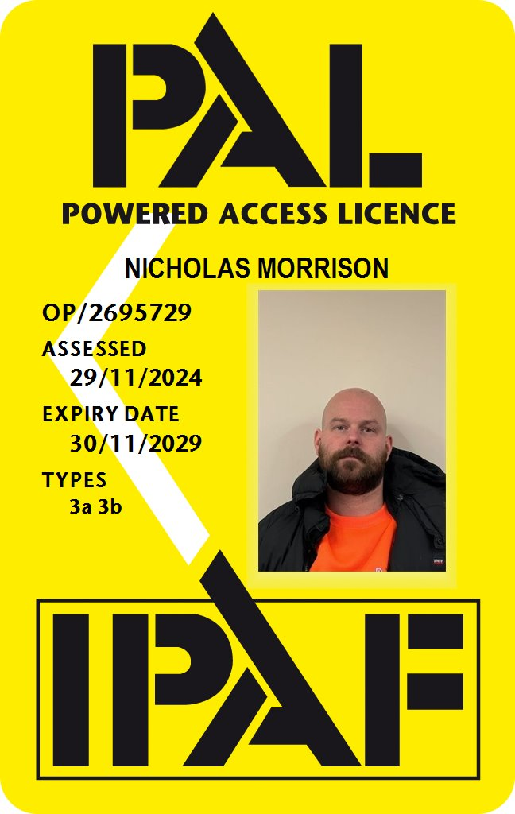
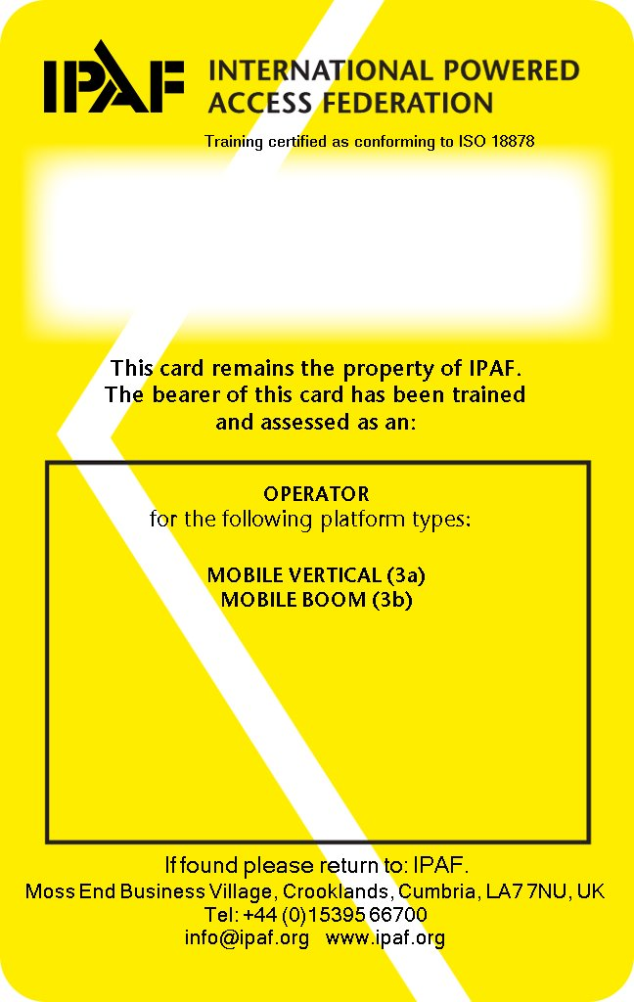
Competency Cards
PAL
www.infratec-uk.com

